Slide 1
District TCAP Results
Spring 2021

Slide 3

Table of Contents
PART I: Overview
PART II: TCAP Data by District
PART III: Response, Recovery and the Path Forward

Slide 4
TCAP Results Demonstrate Urgent Need
Districts and schools across Tennessee worked incredibly hard during the pandemic to provide services to our students.
Both schools and families demonstrated a shared commitment to finding out how our students are performing by achieving a 95% student participation rate on the statewide Spring 2021 TCAP.
Disruptions to education as a result of the pandemic have led to expected declines in academic proficiency in the state, across all subjects and grade bands. These declines were mitigated as a direct result of the hard work of our educators and families.
While declines in proficiency were expected, families, school systems, and the public need access to information that will help drive strategic decision-making to support accelerating student achievement in the years to come.
Tennessee is well-prepared and will continue to focus on doing what’s best for our kids.

Slide 5

COMBINED PROFICIENCY
OVERVIEW: ALL STUDENTS, GRADES & SUBJECTS
KEY TAKE-AWAYS
2020-21 TCAP data shows decreases in students scoring Mastered and On Track and increases in students scoring Approaching and Below.
While this year’s results track with state projections, Tennessee prevented the severe proficiency drops that some states have experienced due to the pandemic due to the extraordinary efforts of our school systems and families.
Students whose scores were most negatively impacted were economically disadvantaged students, urban/suburban students, English learners, and students of color.
Proactive State Solutions: 2021 Special Legislative Session legislation; Strategic investments in summer programming; Reading 360 initiative; TN ALL Corps; Innovative High Schools; Student Support Grants; Grow Your Own; Family Resources
NO
TESTING
SPRING
2020
SOURCE: Tennessee Department of Education, 2021

Slide 6
COMBINED PROFICIENCY
RESULTS BY STUDENT GROUP
ASIAN
BLACK or AFRICAN AMERICAN
ECONOMICALLY
DISADVANTAGED
ENGLISH LEARNERS
HISPANIC
STUDENTS
WITH DISABILITIES
WHITE
Declining proficiency rates over the past five years have been a challenge across most student groups. Because children across the state experienced the pandemic differently, learning supports should be tailored and targeted to individual student needs.

Slide 7
2020-21 PROFICENCY BY OPERATING MODEL
Students learning in person were more likely to score On Track or Mastered. Tennessee districts did exceptional work to keep school buildings open; however, even students attending in person may have missed classroom learning time due to quarantine, demonstrating the widespread impact of the pandemic.
ELEMENTARY
MIDDLE
HIGH
SOURCE: Tennessee Department of Education, 2021

Slide 8
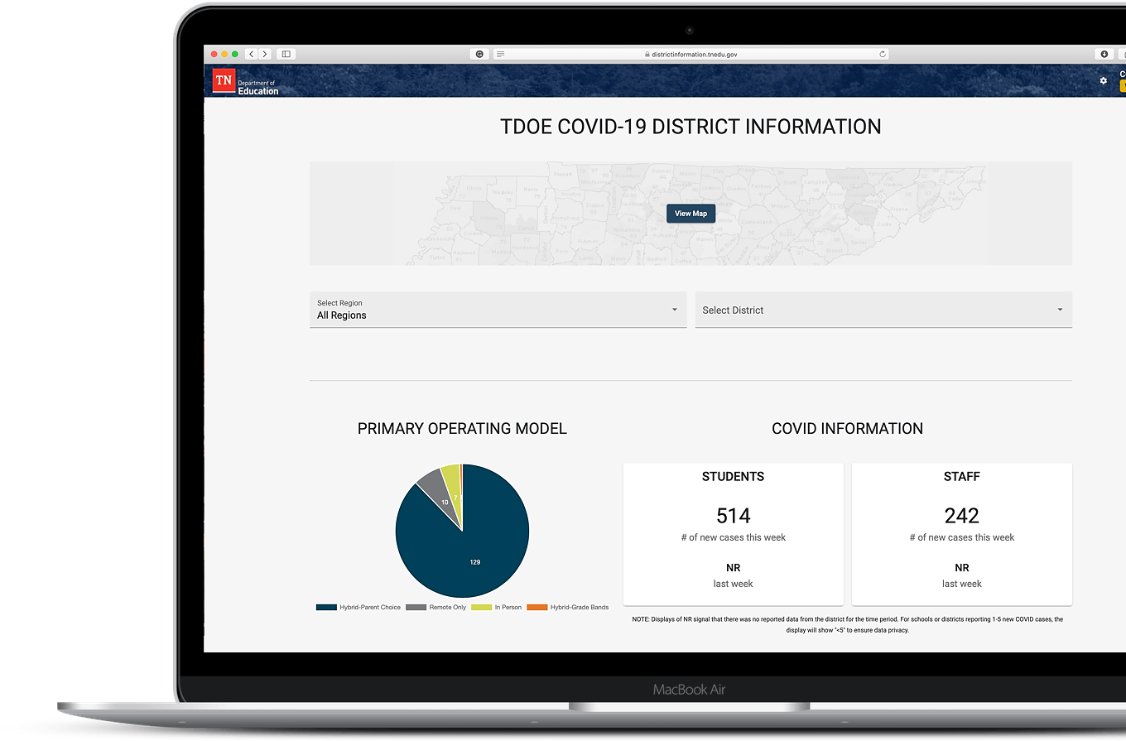
Context for 2020-21 Spring TCAP
The models “In person”, “Hybrid”, and “Remote” represent the primary district operating models for the 2020-21 school year, as reported to the Tennessee Department of Education via the COVID-19 District Information Dashboard.
Not all districts had proportionate representation of student groups participating in assessments.
These analyses do not include the results of TCAP-Alt assessments (for students with the most significant learning disabilities.)

Slide 9

ELA
ALL STUDENTS OVERVIEW
KEY TAKE-AWAYS
3 in 10 Tennessee students are meeting grade level expectations in English Language Arts (ELA).
Overall proficiency in ELA dropped 5 points from 2019.
Proactive State Solutions: Summer Programming; TN Literacy Success Act and Reading360; TN ALL Corps; personalized reading supports with district networks
SOURCE: Tennessee Department of Education, 2021

Slide 10
ELA
OVERVIEW
KEY TAKE-AWAYS
ELEMENTARY
MIDDLE
HIGH
In ELA, 2nd & 3rd grades scores show large increases in students scoring Below.
The rate of 2nd graders scoring Below increased 68%
The rate of 3rd graders scoring Below increased 47%
Students scoring Below in 2nd and 3rd grades are typically those who are not able to read proficiently.
The largest categorical drops in ELA across each test were in writing and conventions of writing.
SOURCE: Tennessee Department of Education, 2021

Slide 11


MATH
ALL STUDENTS OVERVIEW
KEY TAKE-AWAYS
1 in 4 Tennessee students is meeting grade level expectations in math.
Consistent with national trends, math saw the sharpest declines of any subject area besides science, as projected. Overall proficiency dropped 12 points from 2019.
The greatest drops across subject areas were understanding and using mathematical notation to describe quantitative relationships and situations.
Proactive State Solutions: Investments in math adoption and instructional resources; TN ALL Corps tutoring supports; personalized online math and reading supports for students.
SOURCE: Tennessee Department of Education, 2021

Slide 12
MATH
OVERVIEW
KEY TAKE-AWAYS
Overall 3rd grade proficiency declined from 44% in 2019 to 31% in 2021. Overall 4th grade proficiency declined from 46% in 2019 to 34% in 2021.
In middle school, districts on average saw the number of students in the Below category increase by 50%. Students in remote instruction saw proficiency rates decrease at twice the rate of students in person.
There was general stability in Approaching, but significant increases in the percent of students scoring Below.
ELEMENTARY
MIDDLE
HIGH
SOURCE: Tennessee Department of Education, 2021

Slide 13

ELA
FOCUS
ELEMENTARY SCHOOL
GRADE
3
KEY TAKE-AWAYS
Proficiency rates in 3rd grade ELA declined 38% in 2019 to 32% in 2021.
In 2020-21, stable trends in students scoring Mastered, with more students shifting from On-Track to Approaching.
Data show disproportionate increases in students scoring Below.
Data show the most negative impacts for economically disadvantaged students, urban/suburban students, English learners, and students of color.
SOURCE: Tennessee Department of Education, 2021

Slide 14
MATH
FOCUS
MIDDLE SCHOOL
GRADE
7
KEY TAKE-AWAYS
Proficiency rates in 7th grade math declined from 34% in 2019 to 24% of 7th graders in 2021, which is a significant concern related to Algebra-readiness.
There were slight declines in students scoring Mastered, with significant declines in those scoring On-Track.
There was no change in Approaching and significant declines in Below, which reflects that more grade-level instruction is needed.
Low-income students, urban/suburban students, English learners, and students of color were most negatively impacted.
SOURCE: Tennessee Department of Education, 2021

Slide 15
1 slide explaining why 3rd ELA and 7th Math

Slide 16
1 slide that annotates what people are looking at in each chart and why it matters
(literally arrows pointing to parts of a sample slide and explaining what it tells you)

Slide 17
1 slide more explicitly explaining when you should and should not look at trends based on participation rates,

Slide 18



State Framework for Response
The Tennessee Department of Education will operate with a forward-looking, proactive, and optimistic lens, based on what is possible for students. The state response is firmly rooted in our strategic plan for education, Best for All.
ACADEMICS A strong focus on early literacy and math, with additional learning time delivered through high-dosage tutoring and summer programming.
STUDENT READINESS
Providing students with the pathways and supports they need through innovative high schools and access to advanced courses and non-academic supports.
EDUCATORS
Eliminate teacher vacancies and support strong professional growth and learning through Grow Your Own programs and opportunities.

Slide 19
TCAP Administration Successes
SPRING 2019
FALL 2019
FALL 2020
SPRING 2021
Smooth full TCAP administration.
Smooth online administration of high school End of Course (EOC) and science exams.
Successful paper-based EOC administration with new assessment vendor.
Successful high school EOC administration, despite COVID challenges.
Spring 2020 testing was suspended for all grades.
Successful full TCAP administration.
Strong 95% statewide student participation rate due to testing flexibilities and the efforts of schools and districts.

Slide 20
TCAP Spring 2021
Data Results by District

Slide 21
Type District Name Here
MASTER VERSION – DO NOT EDIT
32%
District Proficiency vs. State
District Student Group Proficiency
-0.2
-0.2
-3.2
-0.2
-0.2
-0.2
-3.2
-0.2
-0.2
SOURCE: Tennessee Department of Education, 2022
Notes:
In person, hybrid or remote notation based on district survey feedback

Slide 22
Achievement School District
94%
35.7%
7.8
*
6.9
*
54.5
8.8
**
*

Slide 23
Achievement School District
94%
39.3%
12.8
*
12.1
23.8
*
14.1
1.8
16.7

Slide 24
Achievement School District
94%
30.2%
3.7
*
2.6
8.3
8.3
2.1
**
3.5

